Slide 1


Python Functions
Making Code Simple, Reusable, and Organized

Slide 2
The Basics
What are functions and why should we use them?

Slide 3
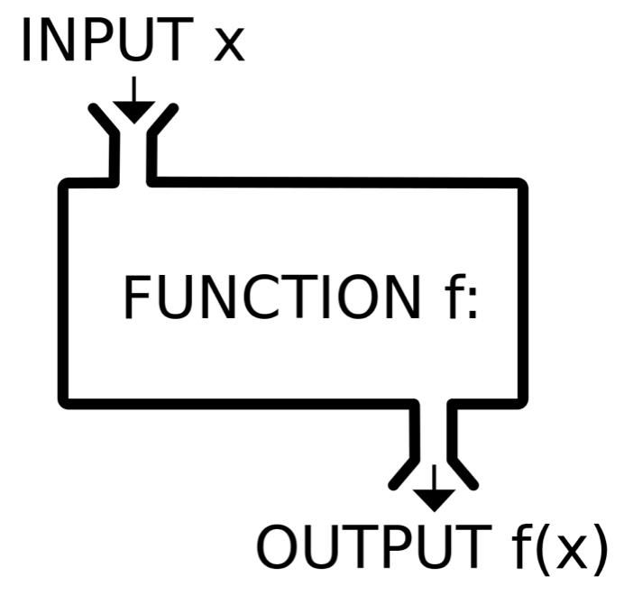

THE FUNCTION MACHINE
What is a Function?
Think of a function as a Kitchen Blender. You give it ingredients (Inputs), it performs a specific task (Mixing), and it gives you a smoothie (Output).
Instead of manually chopping fruit every time, you just press the "Blender" button.
Reusable blocks of code
Performs one specific task
Makes code easier to read

Slide 4
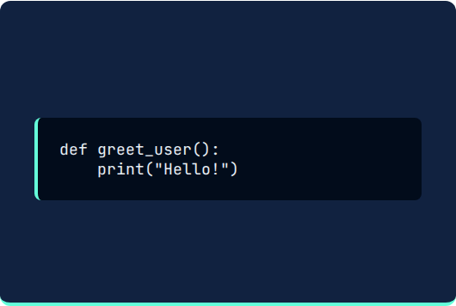
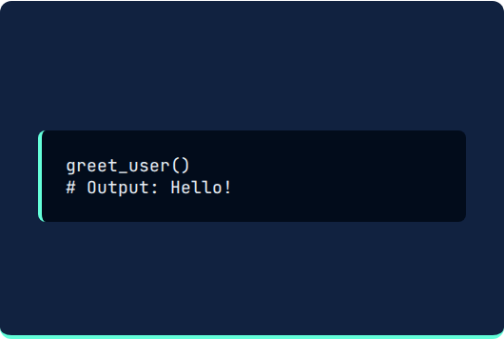
ANATOMY OF A FUNCTION
The Definition
The Call
How we tell Python a function exists.
How we actually run the function.
def is the keyword. greet_user is the name we chose.
The parentheses () tell Python to "go" and execute the task now.

Slide 5
THE 5 GOLDEN RULES
Start with 'def': Always begin with the def keyword to define a new function.
Give it a Name: Pick a descriptive name (e.g., calculate_total instead of f1).
Add Parentheses: Even if there are no inputs, () must be there.
Don't Forget the Colon: The : marks the start of the function's body.
Indentation Matters: All code inside the function must be pushed (indented) to the right.

Slide 6
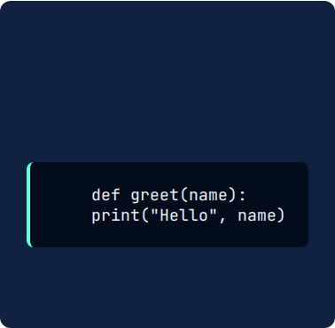
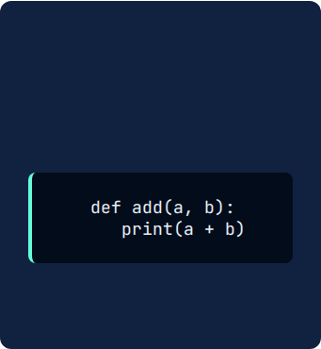




GIVING INSTRUCTIONS (PARAMETERS)
Single Input
Multiple Inputs
The Logic
Pass one piece of data to customize the result.
Separate multiple instructions with commas.
The function uses these inputs like variables inside its body.

Slide 7
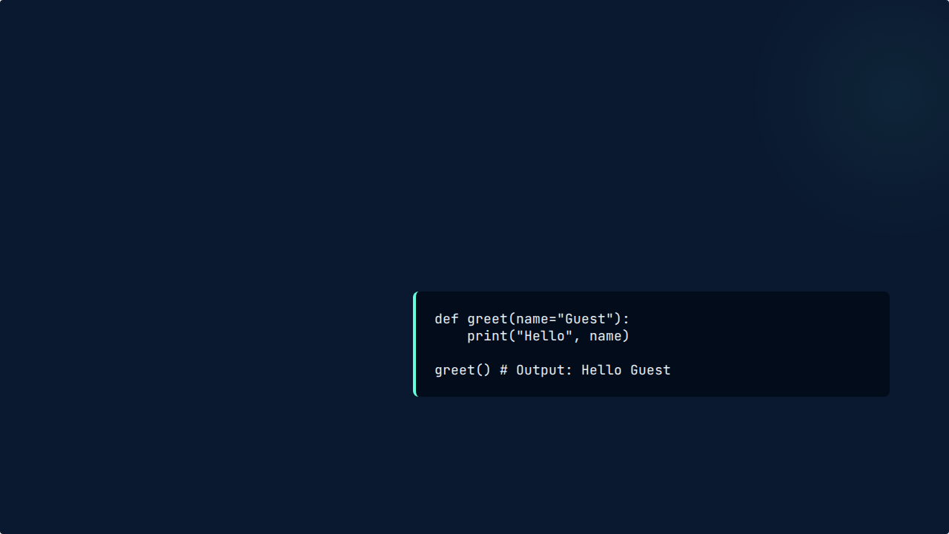
SMART DEFAULTS
What if someone forgets?
99%
You can set a "Plan B" value. If the user doesn't provide an input, Python will use the default value automatically.
Reliability with Defaults

Slide 8
THE RETURN STATEMENT
Sometimes we don't just want to print a result; we want to save it for later. This is what return does.
Action | Code Example | Outcome
Calculate | return a + b | Sends the sum back to the main program.
Stop Early | return | Exits the function immediately.
Store Value | result = add(5, 5) | Variable result now holds the number 10.

Slide 9
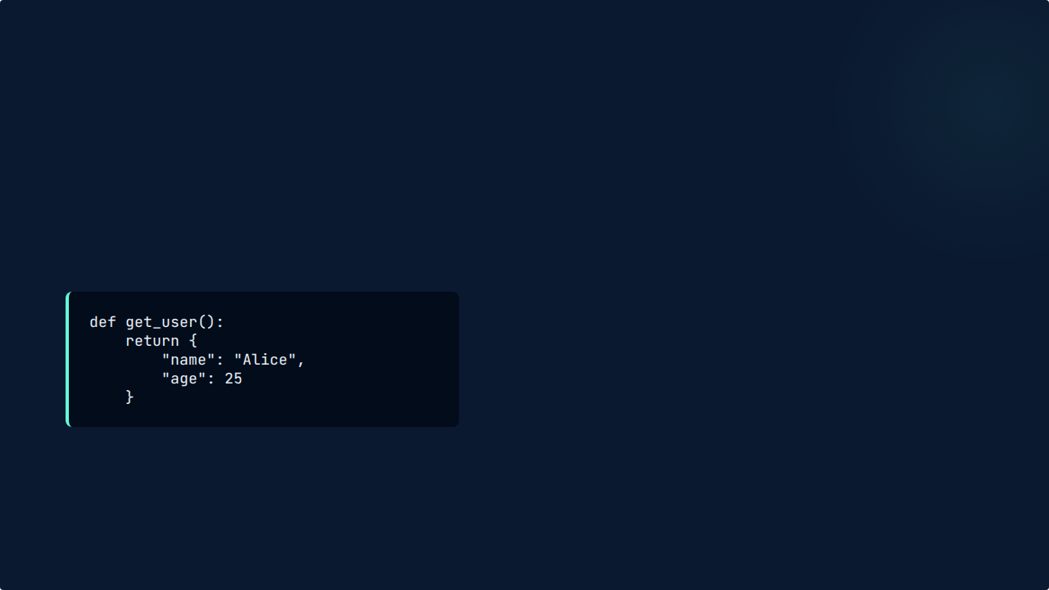

ORGANIZED RESULTS
Returning Dictionaries
Functions can return multiple pieces of data neatly packaged in a Dictionary.
This keeps your data labeled and easy to access by name rather than just a list of numbers.

Slide 10
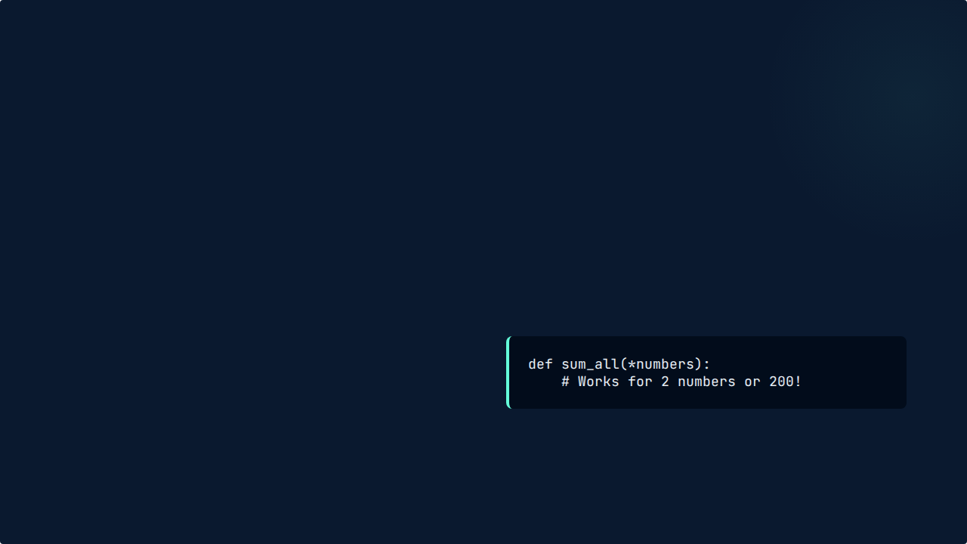

ULTIMATE FLEXIBILITY
What if you don't know how many items are coming? Use *args and **kwargs!
*args: Accepts a list of values.
**kwargs: Accepts labeled values (key-word).
Variable Arguments

Slide 11

HELPING OTHERS
"
"Code is read much more often than it is written."
— Guido van Rossum (Creator of Python)
Use Docstrings (triple quotes """) to explain what your function does so others can use it easily.

Slide 12
Questions?
You are now ready to build your own Python functions!
Happy Coding

